Slide 1
CAAFI 2014
General Meeting
& Expo
Special Ceremony
Produced by

Slide 2
CAAFI 2014
General Meeting
& Expo
Brad Tilden
Chairman, President and Chief Executive Officer, Alaska Airlines
Produced by

Slide 3
2014 General Meeting — Washington, D.C.

Slide 4
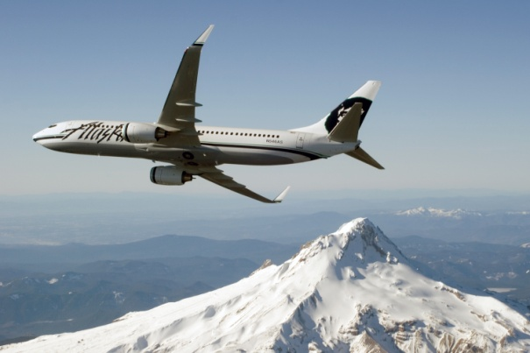
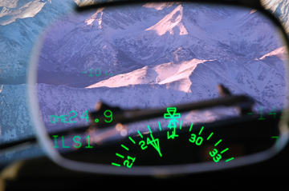
Reducing aircraft emissions
What we fly
How we fly
The fuel we use

Slide 5
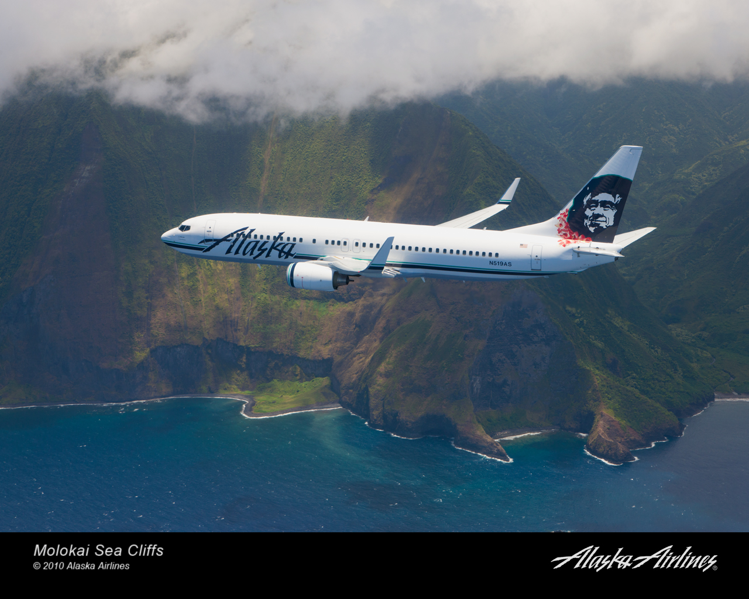
We fly to beautiful places … and we want to keep them beautiful.

Slide 6
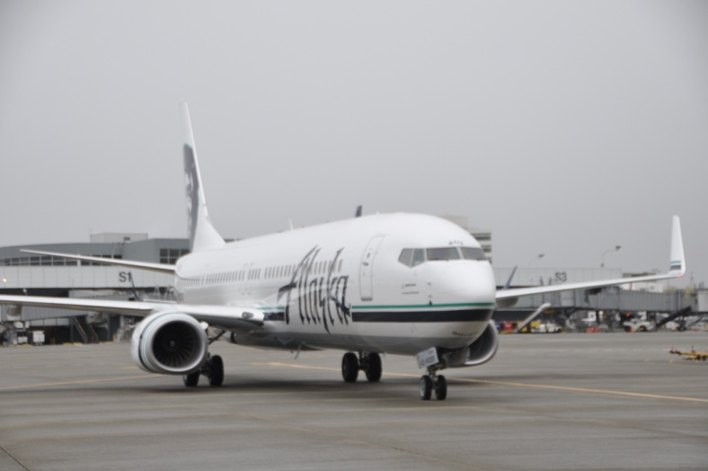
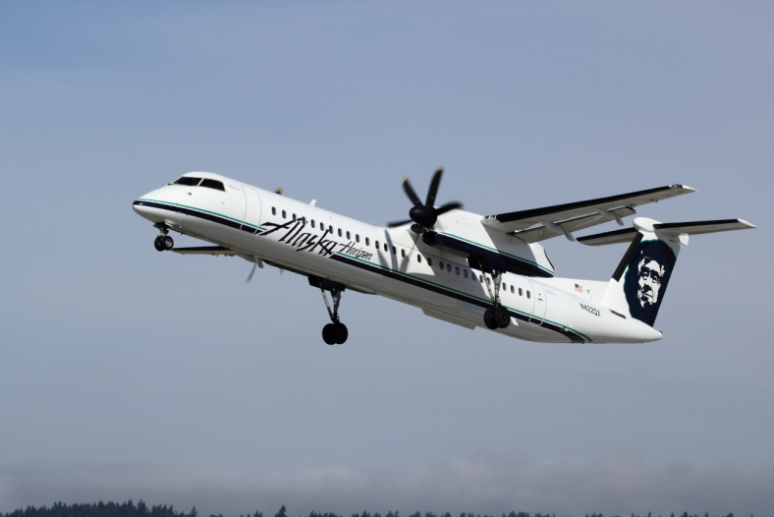
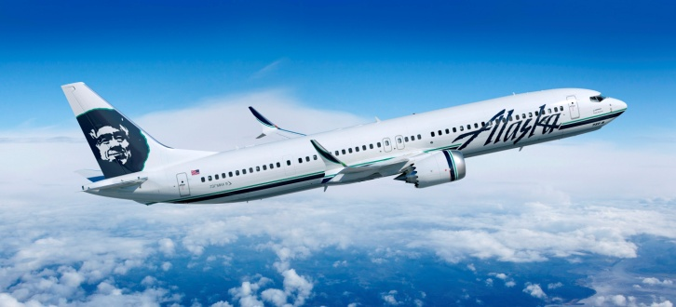
What we fly
Boeing 737-NG
Bombardier Q400
Coming in 2018: Boeing MAX

Slide 7
Alaska among the most efficient
Fuel gallons per seat
22.2
Fuel consumption (gallons / seat)
Seats:
181
172
183
163
149
182
124
144
122
124
140
Better
1,500-mile stage-length
Nominal fuel burn
Pax / bag weight = 220 lbs.

Slide 8
Horizon among the most efficient
Fuel gallons per seat
Fuel consumption (gallons / seat)
Seats:
76
88
99
70
37
50
72
19
Better
400-mile stage-length
Nominal fuel burn

Slide 9
Winglets improve efficiency
100,000 gal. / aircraft annually
58,000 gal. / aircraft
2008
737-800s equipped w/standard winglets Retrofitted -700s, -900s
Efficiency é 3.0%
Total fleet CO₂ emissions ê 79.5k tons
16,600 cars off the road
2014
Retrofitting fleet w/split-scimitar winglets
Efficiency é 1.7%
Total emissions ê 57k tons
11,900 cars off the road
Total fleet CO₂ emissions ê 136.5k tons / 28,500 cars off the road

Slide 10
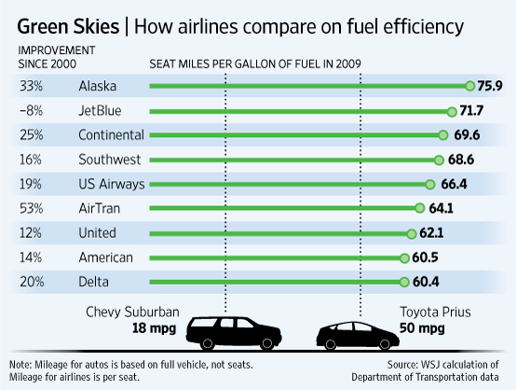
August 2010

Slide 11
How we fly
Single-engine taxi
Taxi times in general
APU on demand for Hawaii flights
En route navigation: most favorable
Approaches: idle power

Slide 12
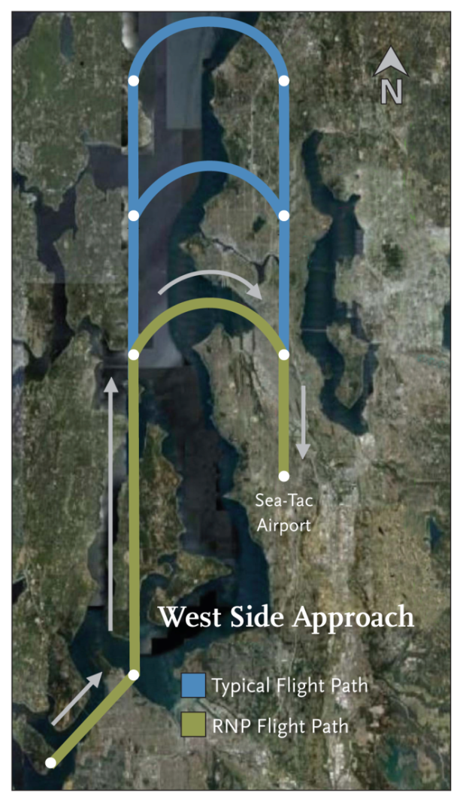
‘Greener Skies’
Eliminates noise for 750k people
Saves airlines 2 million gallons of fuel annually
Cuts pilot-air traffic controller workload in half
Shows potential
of FAA’s NextGen ATC system

Slide 13
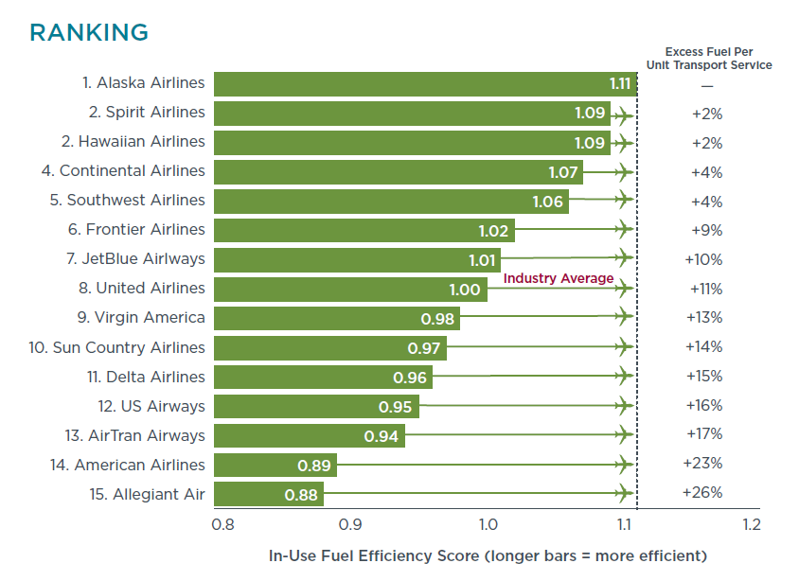

Slide 14
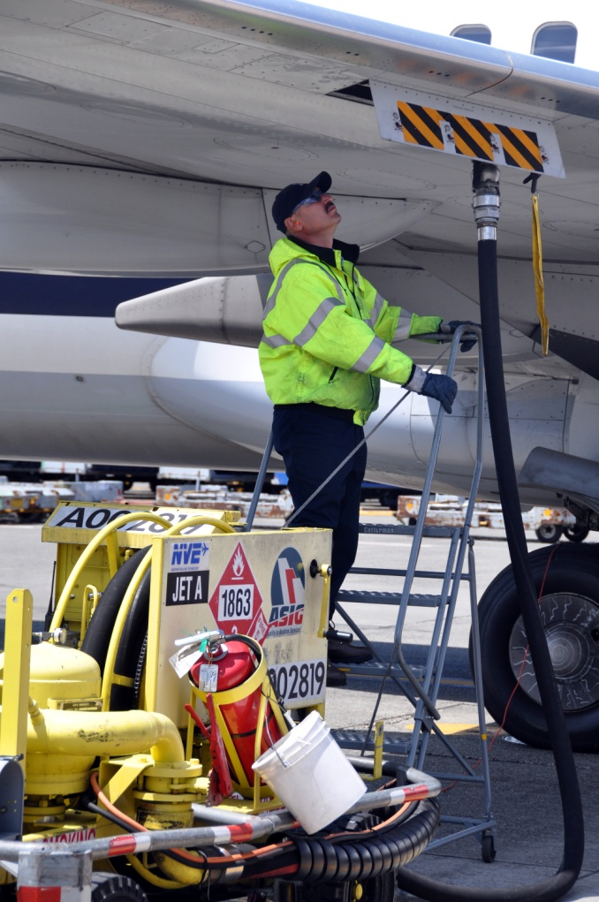
The fuel we use
Alaska burns about 1 million gals. / day
Spent $1.4 billion on fuel in 2013
Our largest expense — 35%
3.2m tons of emissions / 676k cars
U.S. airlines burn 18 billion gals. / year
Cost: $50 billion
160m tons of emissions / 33.3m cars

Slide 15
The fuel we use
75 flights powered by 20% biofuel blend
SEA-DCA on 737s SEA-PDX on Q400s
Fuel cost: $17 / gal.
Showed industry: If you build it, we will buy it.

Slide 16
Biofuel challenges
Scaling up to a sustainable supply
Pricing biofuel competitively
Drop-in distribution

Slide 17
Questions

